Slide 1
Global megatrends in Slovakia
Milan Chrenko
Directorate for Environmental Policy, EU Affairs and International Relations
Ministry of Environment of the Slovak Republic
milan.chrenko@enviro.gov.sk

Slide 3
Environment Priorities
CLIMATE CHANGE
CIRCULAR ECONOMY
WASTE PACKAGE
WATER
BIODIVERSITY

Slide 4
Vision of the 7th Environment Action Programme
‘In 2050, we live well, within the planet's ecological limits.
Our prosperity and healthy environment stem from an innovative, circular economy where nothing is wasted and where natural resources are managed sustainably, and biodiversity is protected, valued and restored in ways that enhance our society's resilience. Our low-carbon growth has long been decoupled from resource use, setting the pace for a global safe and sustainable society.’
Source: 7th EU Environment Action Programme

Slide 5
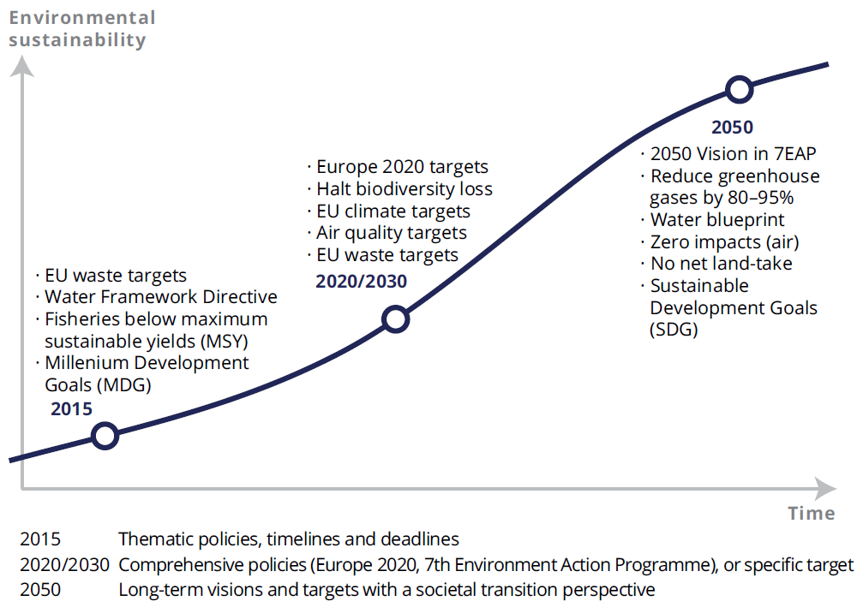
The policy context
Source: EEA Multiannual Work Programme 2014–2018

Slide 6
The overall picture: Efficiency improvements have not secured long-term resilience
20+ years outlook |  |  |  |  |  |  |  |  |  |  |  |  |  |  |  |  |  |  |  | /
Improving trends dominate
Source: EEA. SOER 2015 Synthesis report.
Trends show mixed picture
Deteriorating trends dominate

Slide 7
Global Megatrends
Global megatrends are large-scale, high impact and often interdependent trends visible today that are expected to extend over the decades, changing slowly and exerting considerable force that will influence a wide array of areas including social, technologic, economic, environmental and political dimensions.
EEA, 2007
A megatrend is “composed of other trends […] which themselves also have a major impact in their own right.(1)”
Trends should be regarded as “a pattern of change over time in some variable. (2)” Such patterns of change are driven by social, technological, economic, environmental and/or political developments (drivers). In other words, drivers lead to trends, which lead to megatrends. (1) See http://www.infinitefutures.com/resources/glossary.shtml
Source: EEA. SOER 2015.

Slide 8
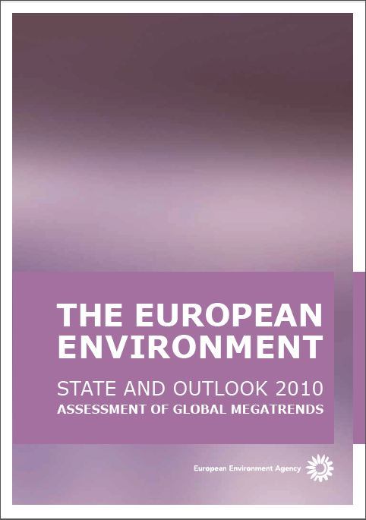
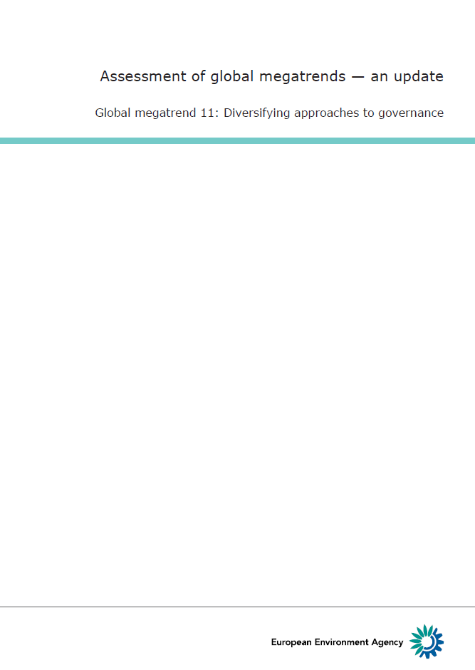
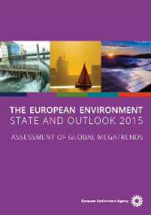
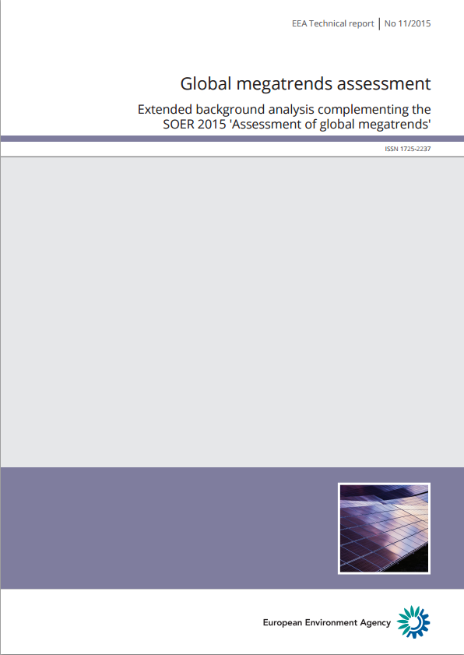
European Environment Agency reports on Global Megatrends
SOER 2010 - Assessment of Global Megatrends (EEA report, 2011)
GMTs background reports and 11 fact sheets (2010 – 2015)
SOER 2015 - Assessment of Global Megatrends (EEA report, 2015)
Assessment of GMTs - extended background analysis (EEA Technical report, 11/2015)

Slide 9
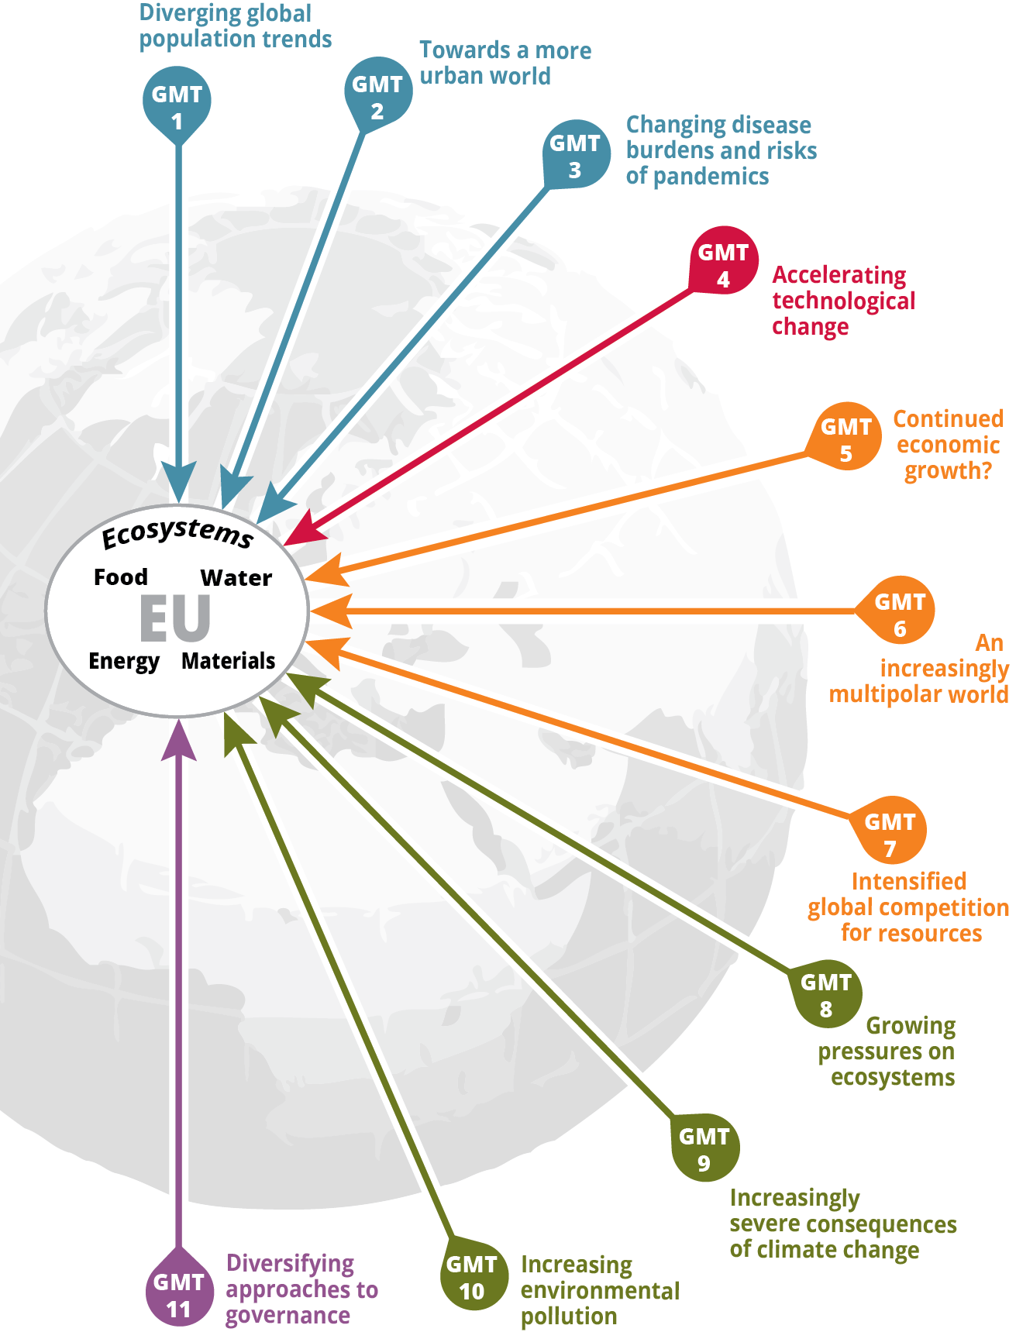
GMT impacts and responses
Global megatrends strongly impact Europe’s ability to meet its basic resource needs:
Food
Water
Energy
Materials
Ecosystems and their services
Europe has opportunities through different response options to shape and adapt to global megatrends
Source: EEA. SOER 2015.

Slide 10
Response options
Europe has two main clusters of response options to global megatrends:
shaping global change in ways that mitigate and manage risks (e.g. via unilateral or multilateral efforts to mitigate environmental pressures)
adapting to global trends (e.g. by anticipating and avoiding harm and by increasing the resilience of social, environmental and economic systems)
Several recent EU policy initiatives have started to embrace the need for long-term, global, and systematic approaches to risk management, e.g.
7th Environmental Action Programme, Roadmap to a resource-efficient Europe, Raw Materials Initiative, Horizon 2020 research and innovation programme.
National initiatives
Source: EEA. SOER 2015.

Slide 11
Tools and methods
National initiatives in Slovakia
Modernization and upgrade of State of Environment reporting is one of the priorities in the Programme of the Slovak government
System for integrated environmental assesment in Slovakia – indicators, regular reports, web presentations
Planning of Assessment reports towards 2020
Modernization and update of regular State of Environment report – to reflect methodological advancements as well as latest developments at the national and international level
Meeting the requirements of national and international agreements/legislation

Slide 12
Tools and methods
GMTs in Slovakia
To support the understanding of the global megatrends across Eionet countries and encourage the discussions on possible GMTs impacts on the environment and implications for policies at the European - regional - national level.

Slide 13
Tools and methods
GMTs in Slovakia
Two strands of activities:
Joint project of European Environment Agency and member countries – Slovakia is a part (ongoing)
To understand implications of GMTs at the national level and to feed back to European level (country workshops, country study)
To assess and understand impacts of GMTs in Slovakia and feed into the decision making (Environmental policy, SOE reporting, raising the awareness...)
Slovak EPA, SAS Institute for Forecasting, Ministrz of the Environment
To build capacities and policy uptake for Participatory scenarios development and analysis in environment (planned for 2017-2020)

Slide 14
Thank you

Slide 15
Communication and Social Media
www.eu2016.sk
@skpres2016
EU2016 SK
Slovak EU Presidency
oez@enviro.gov.sk

